Slide 1


“Jai Sri Gurudev” S J C INSTITUTE OF TECHNOLOGY DEPARTMENT OF INFORMATION SCIENCE AND ENGINEERING
The Project Phase One Review
On
“REAL-TIME ATTENTION SPAN TRACKING
IN ONLINE EDUCATION”
PRESENTED BY
ADARSH K R 1111111 1111 11111111111SJ19IS002
RAKSHITHA H G 1SJ19IS128
G YOGA SAI GANESH 1SJ19IS036
GOVARDHAN J A 1SJ19IS037
Under the guidance of
Prof. Ambika L G

Slide 2
OBJECTIVES
REAL-TIME ATTENTION SPAN TRACKING IN ONLINE EDUCATION
The purpose of attention span detection during online classes is to gather data and analyze the state of the student, to evaluate his performance based on concentration level, instead of just academic scores.
To present a method that uses a camera feed and a mouthpiece contribution to monitor student's continuing attention levels during online classes.
To improve the quality of online education.
To tackle the issues involved in online education using five parameters. We used the face recognition model to verify the student attending the online class.
we have implemented and used lightweight models to reduce the processing time.
We visualize the scores in the form of a live graph and generate automated reports

Slide 3
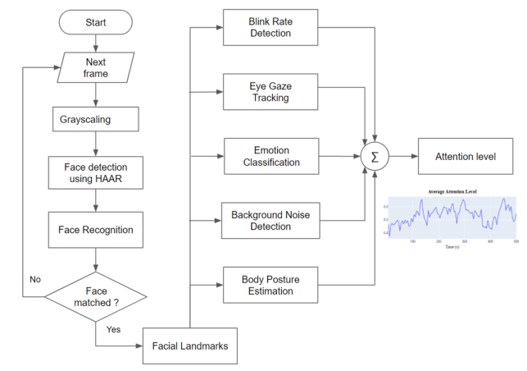
SYSTEM ARCHITECTURE:
REAL-TIME ATTENTION SPAN TRACKING IN ONLINE EDUCATION
..

Slide 4
SYSTEM ARCHITECTURE(cont..)
REAL-TIME ATTENTION SPAN TRACKING IN ONLINE EDUCATION
This system makes use of five parameters to calculate the attention-span level of the student attending the online class.
Facial recognition is used to validate the student’s attendance.
The attention span score is calculated using blink rate, facial expression, eye gaze, background noise, and body posture and is updated continuously for a window length of 5 seconds.
Instead of sequential execution, all the models required to calculate the attention span are executed in parallel once the online lecture starts.

Slide 5
METHODOLOGY
REAL-TIME ATTENTION SPAN TRACKING IN ONLINE EDUCATION
We are planning to implement this project using the following steps.
To detect Facial Landmark we are using Haar cascade algorithm.
To Face Recognition we are using LBPH algorithm
To detect body pose we are using CNN or R-CNN

Slide 6
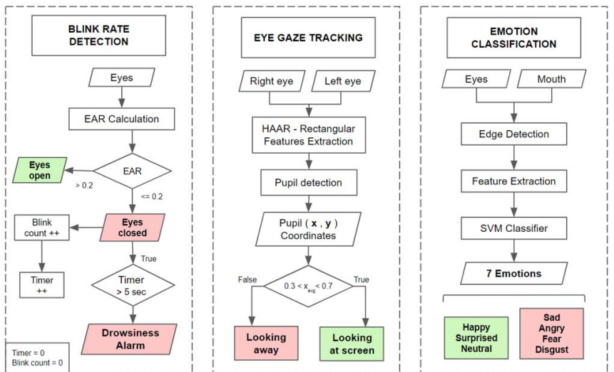
FLOW CHARTS
REAL-TIME ATTENTION SPAN TRACKING IN ONLINE EDUCATION

Slide 7
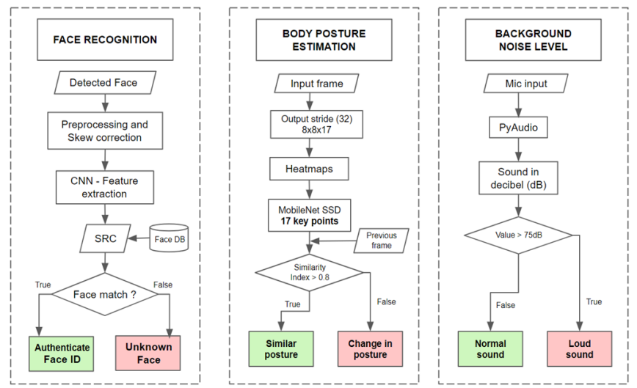
FLOW CHART(Cont..)
REAL-TIME ATTENTION SPAN TRACKING IN ONLINE EDUCATION

Slide 8
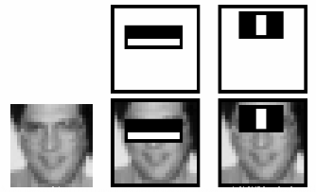
METHODOLOGY-HAAR Cascade
REAL-TIME ATTENTION SPAN TRACKING IN ONLINE EDUCATION
Integral Images are used to make this super fast.
But among all these features we calculated, most of them are irrelevant.
For example, consider the image below. Top row shows two good features. The first feature selected seems to focus on the property that the region of the eyes is often darker than the region of the nose and cheeks. The second feature selected relies on the property that the eyes are darker than the bridge of the nose. But the same windows applying on cheeks or any other place is irrelevant.
Integral Images are used to make this super fast.

Slide 9
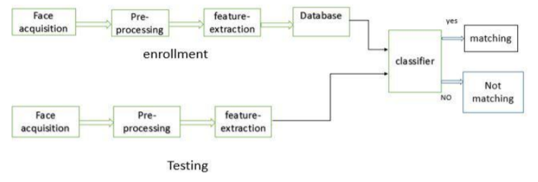
METHODOLOGY-LBPH
REAL-TIME ATTENTION SPAN TRACKING IN ONLINE EDUCATION
Local Binary Patterns Histogram algorithm. It is based on local binary operator. It is widely used in facial recognition due to its computational simplicity and discriminative power.
The steps involved to achieve this are:
creating dataset
face acquisition
feature extraction
Classification
The LBPH algorithm is a part of opencv.

Slide 10
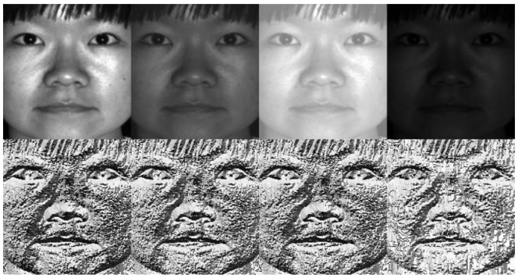
METHODOLOGY-LBPH
REAL-TIME ATTENTION SPAN TRACKING IN ONLINE EDUCATION
STEPS:
The LBP operator is robust against monotonic gray scale transformations.
After the generation of LBP value histogram of the region is created by counting the number of similar LBP values in the region.
After creation of histogram for each region all the histograms are merged to form a single histogram and this is known as feature vector of the image.

Slide 11
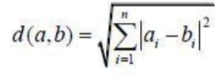
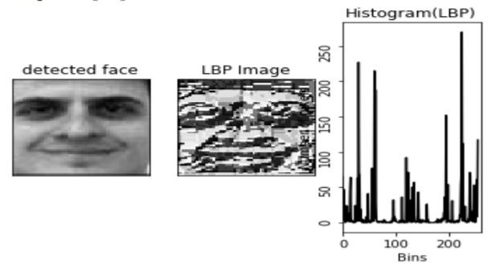
METHODOLOGY-LBPH
REAL-TIME ATTENTION SPAN TRACKING IN ONLINE EDUCATION
STEPS:
Now we compare the histograms of the test image and the images in the database and then we return the image with the closest histogram.
( This can be done using many techniques like euclidean distance, chi-square, absolute value etc )
The Euclidean distance is calculated by comparing the test image features with features stored in the dataset. The minimum distance between test and original image gives the matching rate.
As an output we get an ID of the image from the database if the test image is recognized.

Slide 12
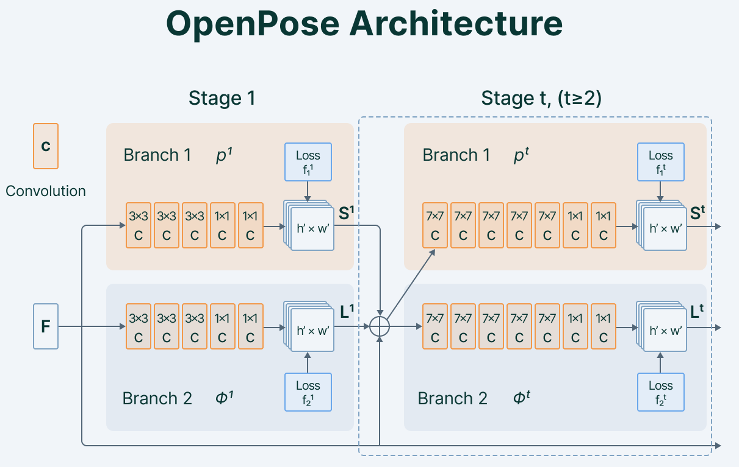
METHODOLOGY-CNN
REAL-TIME ATTENTION SPAN TRACKING IN ONLINE EDUCATION
Open Pose also uses CNN as its main architecture. It consists of a VGG-19 convolutional network that is used to extract patterns and representations from the given input.
The output from the VGG-19 goes into two branches of convolutional networks.

Slide 13
Plan Of Execution
REAL-TIME ATTENTION SPAN TRACKING IN ONLINE EDUCATION
During the execution phase ,the project team develops the product or service and presents final product to customer
There are 3 execution phases
Build Deliverables:
We have completed the first two phases of this project. We begins by reviewing the requirements of the project.
Monitor and Control:
This is the part of the execution phase because we must follow several steps to ensure the project meets the requirements such as
Time management: During the time management process , we controls the amount of time our team members spend working on each activity and monitor the stakeholders at the end of the project.
Change management: if a change in the project’s scope of work we must formally request the change and get the changes approved.
Risk Management: This involves handling the potential disadvantages and drawbacks that may arise during a project.
Review: This helps you document the results of our project review , at the end of the execution project phase.
This is conducted at the end of the initiation, planning and execution phases within a project.
Project is currently delivering to schedule.
Risks have been controlled and mitigated.
Changes were properly managed.
Project is on task.

Slide 14
Plan Of Execution
REAL-TIME ATTENTION SPAN TRACKING IN ONLINE EDUCATION
 | Oct 15 | Dec 10 | Jan 10 | Mar 10 | Apr 15 | May 15 | Jun 25 | Jun 26 | Jun 30 | Jul 1
Planning phase
Literature survey
Analysis phase
Design phase
Implementation
Testing
Deployment
Documentation Report

Slide 15
..
REAL-TIME ATTENTION SPAN TRACKING IN ONLINE EDUCATION
THANK YOU
..
2022-23
Dept of ISE, SJCIT
15

